Slide 1
Speed time and distance
PRATYUS PRATYE

Slide 2
AGENDA
Concepts
Explanation
Class Exercise
Practice, Practice & Practice
Class Test/Recap
Open Discussion
Different types of questions asked

Slide 3
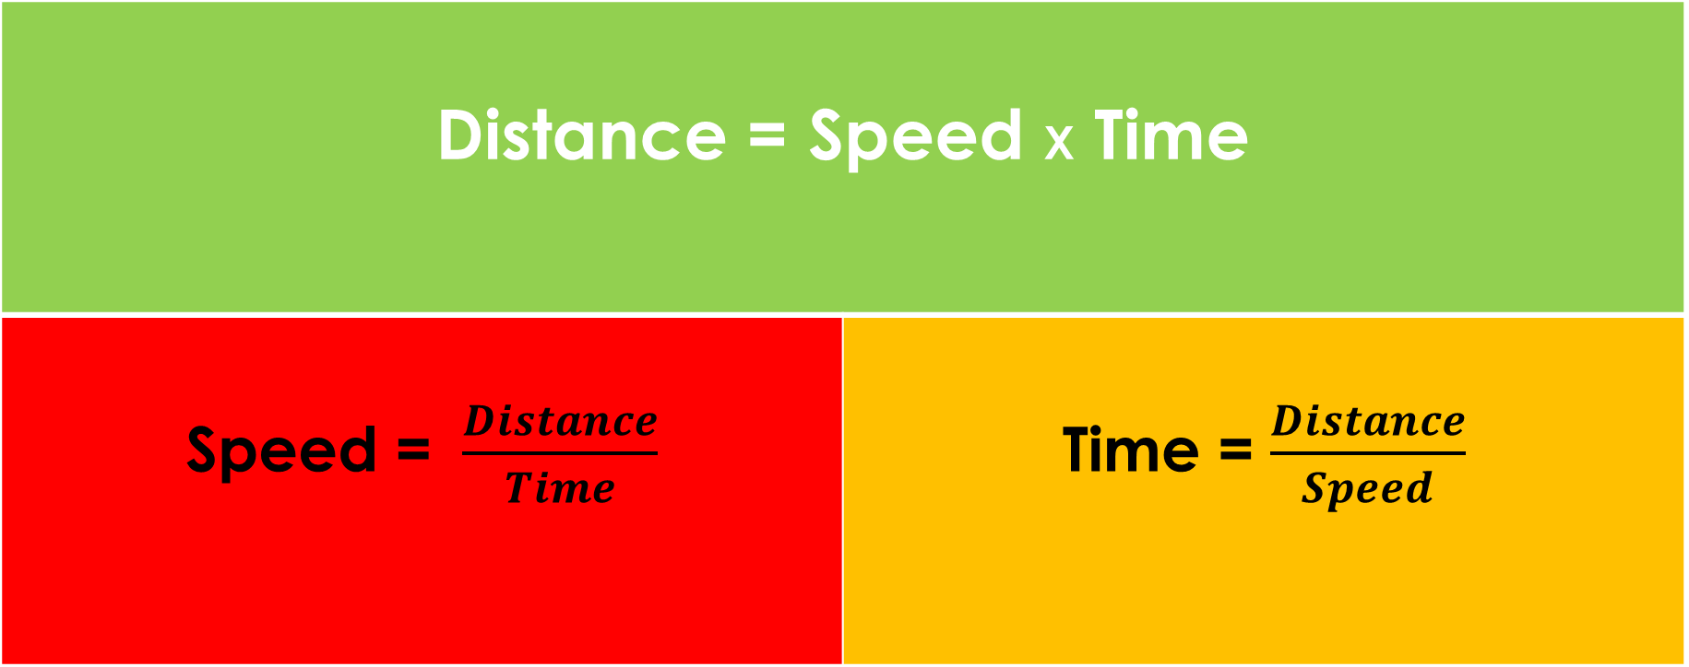
Distance = Speed X Time
Speed = $\frac{Distance}{Time}$ | Time = $\frac{Distance}{Speed}$

Slide 4
Conversion
1 kmph=𝒌𝒊𝒍𝒐𝒎𝒆𝒕𝒆𝒓/ 𝒉𝒐𝒖𝒓
=𝟏𝟎𝟎𝟎 𝒎𝒆𝒕𝒆𝒓𝒔 /𝟔𝟎𝒎𝒊𝒏𝒔
=𝟏𝟎𝟎𝟎𝒎𝒆𝒕𝒆𝒓𝒔 /𝟑𝟔𝟎𝟎𝒔𝒆𝒄𝒔
=𝟓 𝒎𝒆𝒕𝒆𝒓𝒔 𝟏𝟖𝒔𝒆𝒄
= 𝟓/𝟏𝟖 m/sec

Slide 5

Average Speed
Average speed= $\frac{Total Distance}{Total Time}$
Find average speed in following case
1. D1= 10 D2=20
T1=4 T2=6
2. D1= 10 D2=20
S1=2 S2=5
3. S1=4 S2=6
T1=4 T2=6

Slide 6
problems
1.What is the average speed if a man travels 1/2 the time at speed of 40kmph, 1/3 the time at 50kmph and rest of the time at 60 kmph?

Slide 7
problems
2. If I travel along the three sides of an equilateral triangle at speeds of 30kmph, 40kmph and 50kmph respectively, what is my average speed for the entire journey

Slide 8
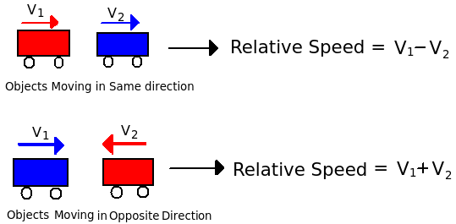
Relative speed
Case 1 | Two bodies are moving in opposite directions at speed V1 & V2 respectively. | Vr =|V1+V2|
Case 2 | Two bodies are moving in same directions at speed V1 & V2 respectively. | Vr =|V1-V2|

Slide 9
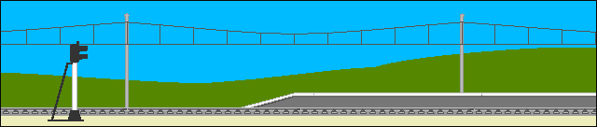

trains
TYPE1: A NON MOVING OBJECT AND TRAIN

Slide 10
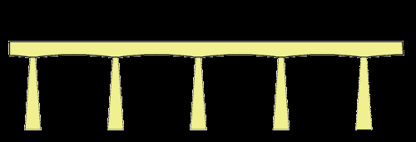
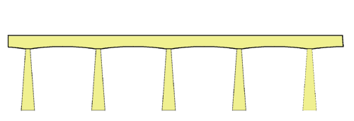
problems
TYPE 2: A BRIDGE AND TRAIN

Slide 11
trains
TYPE 3: A MOVING MAN AND TRAIN

Slide 12
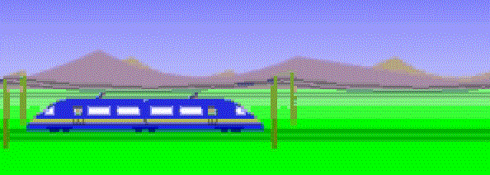

problems
TYPE 4: TWO TRAIN

Slide 13
TRAINS
Case 1: | Train Crossing a tree | Total Distance = Length of train Speed = Speed of train+ 0 (Speed of stationary object)
Case 2: | Train crossing a Platform | Total Distance = Length of first train + Length of Platform Speed = Speed of train
Case 3 | Train crossing moving Man | Total Distance = Length of train Speed (Relative) = Speed of first train (+/-) Speed of second train
Case 4 | Two trains crossing each other | Total Distance = Length of first train + Length of second train Speed (Relative) = Speed of first train (+/-) Speed of second train

Slide 14
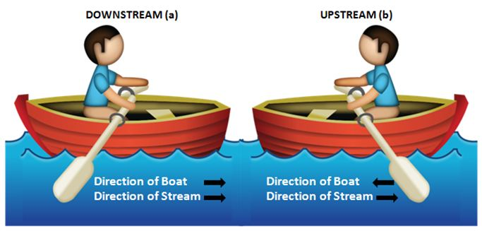
Boat and Stream

Slide 15
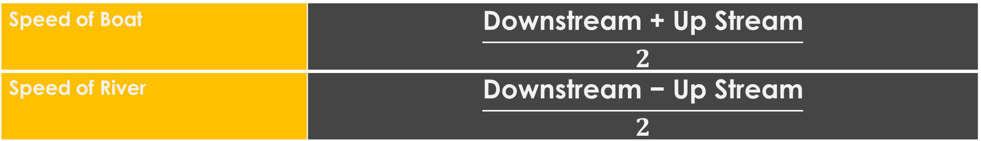
Boat and stream
Downstream | Relative speed = Speed of Boat + Speed of River
Up Stream | Relative speed = Speed of Boat - Speed of River
Let U= Speed of the boat in still water V=Speed of the stream.
Downstream | Distance covered= (U+V) T
Up Stream | Distance covered= (U-V) T
Speed of Boat | $$\frac{\text{Downstream}\text{ + }\text{Up} \text{Stream}}{2}$$
Speed of River | $$\frac{\text{Downstream} \text{−} \text{Up} \text{Stream}}{2}$$

Slide 16
race
Two types of Races
Linear race
Circular race
Linear Race
Speed = S1-S2

Slide 17
Circular motion
The relative Speed of 2 bodies moving around a circle in the same direction is taken as (V1-V2) and while moving in opposite direction is taken as (V1+V2)
Case 1 | First Meeting | Two or more bodies start moving simultaneously from the same point on the circumference of the circle. | First meeting time = Circumference / Relative Speed
Case 2 | First Meeting at starting point | The first meeting at the starting point will occur after a time that is obtained by the LCM of the times that each of the bodies take to complete one full round. | T=LCM of(T1 and T2)

Slide 18
1.If a person moving at the speed of 2.5 km/hr travels from Goa to Mandya in 1 day and 10 hr (assume he does not stop anywhere). Find the distance between Goa & Mandya.
2. In the above problem, if a person wants to reach Mandya back in 17 hr, at what speed should he move?

Slide 19
problems
3. Pandya has a run-up of 100 m. If the speed at which he runs is 36 Km/hr, how much time does he take to complete his run- up?

Slide 20
problems
4. Virat sees Anushka standing at a distance of 200 m from his position. He increases his speed by 50% and hence takes 20s now to reach her.
a. If he travels at the original speed, how much time will he take?
b. What was his original speed (in km/hr)?
c. What is his new speed?

Slide 21
problems
5. If instead of going at my usual speed of 30 Kmph, I go to office at 40 kmph, I reach office 10 minutes early. What is the usual time I take to reach office and what is the distance I travel?

Slide 22
problems
6. Two bicycles cover the same distance at 15km/hr and 16 km/hr respectively. Find the distance travelled by each, if one takes 16 min. longer than the other

Slide 23
problems
7. Buses take 12 hr to cover a distance of 120 km between A and B. A bus starts from A at 8:00a.m. and another bus starts from B at 10:00 a.m. on the same day. When do the two buses meet?

Slide 24
problems
8. A, B and C start swimming simultaneously from the same end of a pool. To complete 10 laps, A takes 10 mins, B takes 8 mins and C takes 6 mins. What is the ratio of speeds of A, B and C.

Slide 25
problems
9. Mr. Ghosh arrives at his office 30 min late every day. On a particular day, he reduces his speed by 25% and hence arrived 50 min late instead.
a. Find how much time would he take to travel to his office if he decides to be on time on a blue moon day?
b. If he has to arrive on time, by what percentage should he increase his speed?

Slide 26
problems
10. Ram and Shyam are two friends whose homes are 30km apart. Ram calls up Shyam on the phone and they decide to meet somewhere between their houses. Ram rides 4 Km/hr and Shyam at 6 Km/hr, and they start simultaneously from their respective homes.
a. At what distance from Shyam’s house will they meet? b. After how much time will they meet?

Slide 27
problems
11. A train met with accident 150km from station A. It completed the remaining journey at 56 of the previous speed and reached 15 min late at station B. Had the accident taken place 30 km further, it would have been only 7 min late. Find the speed of the train and the distance between the two stations A and B

Slide 28
problems
12. Mr. Ghosh Babu leaves his house daily at a particular time to go to his office. He reaches office 10 minutes late when he travels at 20 kmph and 5 minutes early when he travels at 30 kmph. At what speed should he travel to reach office on time?

Slide 29
problems
13. A and B start from point X towards Y and C from Point Y towards point X simultaneously from opposite ends, X and Y respectively of a swimming pool of length 200mts. A cross B, reaches the opposite end Y and turns back immediately and again meets B at a distance of 120mts from X. Find the ratio of the speeds of A and B if
i. B has not yet reached the opposite end even once ii. B has reached opposite end once and turned back.

Slide 30
problems
14. Consider a square ABCD. X starts from A and travels continuously along the path ABDCA and Y starts from B and continuously moves along path BCADB. If speed of X and Y are equal, how many times would they have met when X has completed 10 laps and reached the starting point A again?

Slide 31
problems
15. A and B start from opposite ends X and Y towards Y and X respectively. They meet on the way at Z and if A and B take 36 and 25 minutes respectively after meeting to reach their ends, what is the ratio of speeds of A and B ?

Slide 32
problems
1.In the movie Ghulam, Aamir is able to spot the train when it is 2km away coming towards him. The train is moving at a constant speed of 36 km/hr. The red handkerchief is near a pole 400 m away from Aamir in the same direction in which the train is travelling. How fast must Aamir run in order to reach the pole and just be saved from being overrun?

Slide 33
problems
2. A thief escapes from police station A in a jeep and starts driving towards B at a speed of 60kmph. The police realize the escape after 2 hours and immediately call up the police station at B (400kms from A) to send a team towards A to nab the thief on way. The team from B travel at speed of 40kmph. At the same time a team from A leaves for B with a speed of 80kmph. At what distance from A will the thief be caught? By which team? And after how many hours will be other team reach the spot of capture?

Slide 34
problems
3. A thief is spotted by a policeman at a distance if 200m. If the speed of the thief be 10km/hr and that of the policeman be 12km/hr, at what distance will the policeman catch the thief?

Slide 35
Trains problems
1. A train of length 500m travelling at 72km/hr approaches a man standing on the platform. How much time does it take to completely cross him?

Slide 36
problems
2. Refer to previous question, if the man also starts moving in the same direction as the train, at a speed of 10.8 km/hr, then what is the time taken by the train to cross the man?

Slide 37
problems
3. In the previous problem, if the man moves in the direction opposite to that of the train, what is the time taken by the train to cross the man?

Slide 38
problems
4. If the length of a train and a platform are 500m and 700m respectively, find the time taken by the train moving at 54 km/hr to cross the platform.

Slide 39
1. | A train running at the speed of 60 km/hr crosses a pole in 9 seconds. What is the length of the train?
A. | 120 metres
B. | 180 metres
C. | 324 metres
D. | 150 metres

Slide 40
2. | A train 125 m long passes a man, running at 5 km/hr in the same direction in which the train is going, in 10 seconds. The speed of the train is:
A. | 45 km/hr
B. | 50 km/hr
C. | 54 km/hr
D. | 55 km/hr

Slide 41
3. | The length of the bridge, which a train 130 metres long and travelling at 45 km/hr can cross in 30 seconds, is:
A. | 200 m
B. | 225 m
C. | 245 m
D. | 250 m

Slide 42
4. | Two trains running in opposite directions cross a man standing on the platform in 27 seconds and 17 seconds respectively and they cross each other in 23 seconds. The ratio of their speeds is:
A. | 1 : 3
B. | 3 : 2
C. | 3 : 4
D. | None of these

Slide 43
5. | A train passes a station platform in 36 seconds and a man standing on the platform in 20 seconds. If the speed of the train is 54 km/hr, what is the length of the platform?
A. | 120 m
B. | 240 m
C. | 300 m
D. | None of these

Slide 44
6. | A train 240 m long passes a pole in 24 seconds. How long will it take to pass a platform 650 m long?
A. | 65 sec
B. | 89 sec
C. | 100 sec
D. | 150 sec

Slide 45
7. | Two trains of equal length are running on parallel lines in the same direction at 46 km/hr and 36 km/hr. The faster train passes the slower train in 36 seconds. The length of each train is:
A. | 50 m
B. | 72 m
C. | 80 m
D. | 82 m

Slide 46
8. | A train 360 m long is running at a speed of 45 km/hr. In what time will it pass a bridge 140 m long?
A. | 40 sec
B. | 42 sec
C. | 45 sec
D. | 48 sec

Slide 47
9. | Two trains are moving in opposite directions @ 60 km/hr and 90 km/hr. Their lengths are 1.10 km and 0.9 km respectively. The time taken by the slower train to cross the faster train in seconds is:
A. | 36
B. | 45
C. | 48
D. | 49

Slide 48
10. | A jogger running at 9 kmph alongside a railway track in 240 metres ahead of the engine of a 120 metres long train running at 45 kmph in the same direction. In how much time will the train pass the jogger?
A. | 3.6 sec
B. | 18 sec
C. | 36 sec
D. | 72 sec

Slide 49
11. | A 270 metres long train running at the speed of 120 kmph crosses another train running in opposite direction at the speed of 80 kmph in 9 seconds. What is the length of the other train?
A. | 230 m
B. | 240 m
C. | 260 m
D. | 320 m
E. | None of these

Slide 50
12. | A goods train runs at the speed of 72 kmph and crosses a 250 m long platform in 26 seconds. What is the length of the goods train?
A. | 230 m
B. | 240 m
C. | 260 m
D. | 270 m

Slide 51
13. | Two trains, each 100 m long, moving in opposite directions, cross each other in 8 seconds. If one is moving twice as fast the other, then the speed of the faster train is:
A. | 30 km/hr
B. | 45 km/hr
C. | 60 km/hr
D. | 75 km/hr

Slide 52
14. | Two trains 140 m and 160 m long run at the speed of 60 km/hr and 40 km/hr respectively in opposite directions on parallel tracks. The time (in seconds) which they take to cross each other, is:
A. | 9
B. | 9.6
C. | 10
D. | 10.8

Slide 53
15. | A train 110 metres long is running with a speed of 60 kmph. In what time will it pass a man who is running at 6 kmph in the direction opposite to that in which the train is going?
A. | 5 sec
B. | 6 sec
C. | 7 sec
D. | 10 sec

Slide 54
16. | A train travelling at a speed of 75 mph enters a tunnel 3 miles long. The train is mile long. How long does it take for the train to pass through the tunnel from the moment the front enters to the moment the rear emerges?
A. | 2.5 min
B. | 3 min
C. | 3.2 min
D. | 3.5 min

Slide 55
17. | A train 800 metres long is running at a speed of 78 km/hr. If it crosses a tunnel in 1 minute, then the length of the tunnel (in meters) is:
A. | 130
B. | 360
C. | 500
D. | 540

Slide 56
18. | A 300 metre long train crosses a platform in 39 seconds while it crosses a signal pole in 18 seconds. What is the length of the platform?
A. | 320 m
B. | 350 m
C. | 650 m
D. | Data inadequate

Slide 57
19. | A train speeds past a pole in 15 seconds and a platform 100 m long in 25 seconds. Its length is:
A. | 50 m
B. | 150 m
C. | 200 m
D. | Data inadequate

Slide 58
20. | A train moves past a telegraph post and a bridge 264 m long in 8 seconds and 20 seconds respectively. What is the speed of the train?
A. | 69.5 km/hr
B. | 70 km/hr
C. | 79 km/hr
D. | 79.2 km/hr

Slide 59
problems
5. Two trains of lengths 400m and 600m have the speeds of 36 km/hr and 54 km/hr respectively. In what time will the trains be able to completely pass each other, given that the trains are moving in
a. the same direction with the faster train approaching the slower. b. the opposite direction?

Slide 60
Boat and Stream
1.The speed of a boat in still water is 10m/s and the speed of the stream is 6m/s. If the boat is moving upstream and again downstream, what is the ratio of the time taken to cover a particular stretch of distance in each direction?

Slide 61
problems
2. A boat takes a total of 6 hours to row 8 kms downstream and to return back to the starting point. If speed of the boat is 3kmph, for how much time was the boat moving downstream and for how much time upstream?

Slide 62
problems
3. A man can row upstream at 7 km/hr and downstream at 10 km/hr. Find his rate in still waters and the rate of the current.

Slide 63
problems
1. Laxman joins Saurav and Sachin and all of them run on a circular track of length 500 m in the same direction from the same point simultaneously. Laxman moves at 3 km/hr, Sachin at 5 km/hr and Saurav at 8 km/hr. When will they all be together again
a. for the first time? b. for the first time at the starting point?

Slide 64
Practice Problems
1.How many minutes Raman will take to cover a distance of 400 meters if he runs at a speed of 20 km/hr ?
A.2 mins B.2.5 mins C.1 mins D.None of these

Slide 65
problems
2.John travelled from his town to city. John went to city by bicycle at the speed of 25 km/h and came back at the speed of 4 km/h. If John took 5 hours and 48 min to complete his journey, what is the distance between town and city ?
A.15 km B.22 km C.20 km D.25 km

Slide 66
problems
3.Speed of a train is 20 meters per second. It can cross a pole in 10 seconds. What is the length of train ?
A.150 m B.250 m C.200 m D.300 m

Slide 67
problems
4.Ram walks at a speed of 12 km/h. Today the day was very hot so walked at 5/6th of his average speed. He arrived his school 10 minutes late. Find the usual time he takes to cover distance between his school and home ?
A.40 mins B. 45 mins C.50 mins D.60 mins

Slide 68
problems
5.A car running at 65 km/h takes one hour to cover a distance. If the speed is reduced by 15 km/hour then in how much time it will cover the distance ?
A.72 mins B.78 mins C.76 mins D.None of these

Slide 69
problems
6.In a 100 m race A runs at a speed of 1.66 m/s. If A gives a start of 4m to B and still beats him by 12 seconds. What is the speed of B ?
A.1 m/s B.1.33 m/s C.1.25 m/s D.Rs 1.5 m/s

Slide 70
problems
7.In a kilometre race, A beats B by 100 meters. B beats C by 100 meters. By how much meters does A beat C in the same race ?
A.200 meters B.180 meters C.190 meters D.210 meters

Slide 71
problems
8. Two trains of equal length, running with the speeds of 60 and 40 kmph, take 50 seconds to cross each other while they are running in the same direction. What time will they take to cross each other if they are running in opposite directions?
A. 10 sec B. 9 sec C. 8 sec D. 7 sec

Slide 72
problems
9. If a train, travelling at a speed of 90 kmph, crosses a pole in 5 sec, then the length of train is?
A. 104 m B. 125 m C. 140 m D. 152 m

Slide 73
problems
10. Two trains travelling in the same direction at 40 and 22 kmph completely pass off another in 1 minute. If the length of the first train is 125 m, what is the length of the second train?
A. 125 m B. 150 m C. 175 m D. 185 m

Slide 74
problems
11. How many seconds will a train 100 meters long take to cross a bridge 150 meters long if the speed of the train is 36 kmph?
A. 18 B. 22 C. 25 D. 28

Slide 75
problems
12. A train 100 meters long completely crosses a 300 meters long bridge in 45 seconds. What is the speed of the train is?
A. 32 kmph B. 36 kmph C. 40 kmph D. 48 kmph

Slide 76
problems
13. Excluding stoppages, the speed of a train is 45 kmph and including stoppages it is 36 kmph. Of how many minutes does the train stop per hour?
10 min B. 11 min
C. 12 min D. 13 min

Slide 77
problems
14.A motorcyclist goes from Bombay to Pune, a distance of 192 kms at an average of 32 kmph speed. Another man starts from Bombay by car 2 ½ hours after the first, and reaches Pune ½ hour earlier. What is the ratio of the speed of the motorcycle and the car?
A. 1:2 B. 1:3 C. 10:27 D. 5:4

Slide 78
problems
15. A person can swim in still water at 4 km/h. If the speed of water 2 km/h, how many hours will the man take to swim back against the current for 6km?
A. 3 B. 4 C. 4 (1/2) D. Insufficient data

Slide 79
problems
16. A boat goes 100 km downstream in 10 hours, and 75 m upstream in 15 hours. The speed of the stream is?
A. 7 km/h B. 5 km/h C. 3 km/h D. 2 (1/2) km/h

Slide 80
problems
17. A man can row his boat with the stream at 6 km/h and against the stream in 4 km/h. The man's rate is?
A. 1 kmph B. 5 kmph C. 8 kmph D. 3 kmph

Slide 81
problems
18. A man can swim in still water at 4.5 km/h, but takes twice as long to swim upstream than downstream. The speed of the stream is?
A. 3 B. 7.5 C. 2.25 D. 1.5

Slide 82
problems
19. A man can row with a speed of 15 kmph in still water. If the stream flows at 5 kmph, then the speed in downstream is?
A. 10 kmph B. 5 kmph C. 20 kmph D. 22 kmph

Slide 83

Notes:
http://www.leadthecompetition.in/reasoning/questions-on-relations.html
https://www.sawaal.com/blood-relations-questions-and-answers/a-is-bs-sister-c-is-bs-mother-d-is-cs-father-e-is-ds-mother-then-how-is-a-related-to-d_4150
https://www.toppr.com/guides/reasoning-ability/blood-relations/blood-relations-practice-questions/

